Slide 1
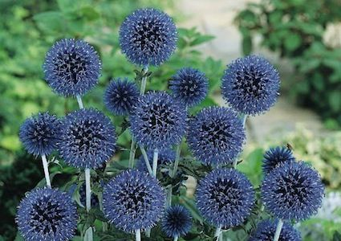
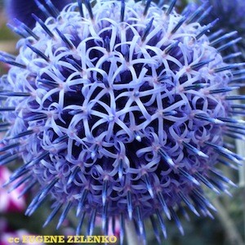
BLUE GLOW Globe Thistle
Echinops bannaticus
This dramatic 3-4 foot perennial has prickly, deeply cut gray-green foliage and many 2 inch vibrant blue flowers in perfectly round heads over a long July to September season The flowers are outstanding in fresh or dried arrangements. Winter hardy to zone 3. Attract butterflies - Intense blue flower heads - Excellent fresh cut or dried - Combine beautifully with Gayfeather, New York Aster, Oriental poppies, and Yarrow

Slide 2
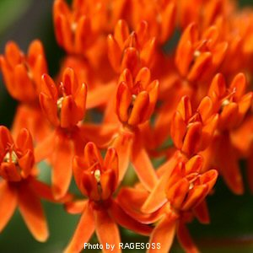
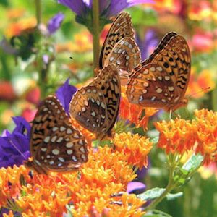
BUTTERFLY WEED (Orange)
Asclepias tuberosa
3 foot plants produce large 6 inch clusters of vibrant orange flowers that attract swarms of butterflies in summer. Winter hardy to zone 3.

Slide 3
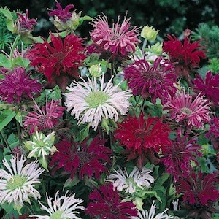
PANORAMA MIX Bee Balm
Monarda didyma
Every year in June and July Panorama Mix produces shaggy semi-double blooms in intense shades of pink, salmon, red, scarlet and crimson. Butterflies and hummingbirds find them irresistible. Leaves are mint scented and used to make Oswego tea. The plants grow to 3-feet tall, are mildew resistant, and thrive in full sun or part shade. A good cut-flower. Winter hardy to zone 3.

Slide 4
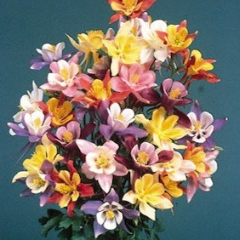
MCKANNA'S GIANT Columbine
Aquilegia x caerulea
Large, long-spurred 2-4 inch flowers in a very wide range of colors including yellow, peach, purple, crimson, scarlet, white, blue and pink. They are excellent for cutting. Grows to 24-36 inches tall. Winter hardy to zone 3. Hummingbirds love them! - Deer resistant - Combine beautifully with Astilbe, Campanula, Forget-Me-Not, Foxglove and Jacob's Ladder - Needs moist soil and afternoon or filtered shade - Can tolerate sun in mild summer areas

Slide 5
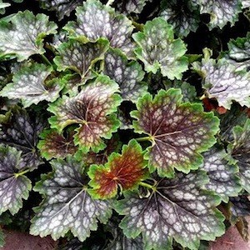
MARVELOUS MARBLE Coral Bells Seeds
Heuchera americana
Brilliant tubular blooms attract hummingbirds - Perfect for massing as a ground cover, edging paths or growing in containers – Combines beautifully in borders with Delphinium, Ornamental Grasses and Lady's Mantle
In spring, foliage emerges purple, then transitions into showy, bright green leaves, overlaid in silver, and veined reddish-purple. Color and pattern rivals that of vegetatively produced varieties. The creamy-white flowers appear on short stems, somewhat earlier than other coral bells. Vigorous, mounding growth to 12 inches high, 18 inches wide. Winter hardy to zone 4.

Slide 6
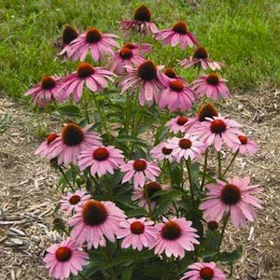
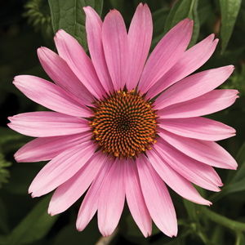
PRAIRIE SPLENDOR
Echinacea aka PURPLE CONEFLOWER
Echinacea purpurea, Echinacea paradoxa
Attracts butterflies all summer long - Easy sowing, germinating and growing - Heat tolerant - Drought and deer resistant - Combines beautifully with Gaura, Jupiter's Beard, Ornamental Grasses, Russian Sage, Stachys, and Yarrow This prairie native has rose-purple 4-inch blooms with downward pointing petals and a prominent orange-tipped cone. It blooms from July-September and is a long lasting cut-flower. Echinacea is a tough, heat tolerant, easy to grow 3-foot perennial. A favorite flower of the Monarch butterfly. Prefers fall or spring planting. Winter hardy to zone 3

Slide 7
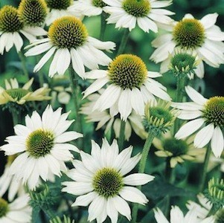
BABY SWAN Coneflower
Very similar to White Swan but the dwarf, well-branched plants grow only to 20 inches tall. They are excellent at the front of the border or in containers.

Slide 8
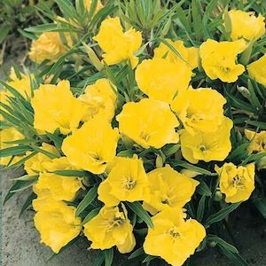
MISSOURI PRIMROSE
Oenothera missouriensis
Certainly one of the most beautiful of the evening primroses it produces clear yellow paper thin blossoms up to 5 inches across from June to September. Grows to 12 inches tall and has a sprawling habit with soft velvety leaves. Winter hardy to zone 4.

Slide 9
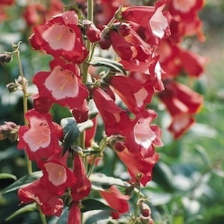
SCARLET QUEEN PENSTEMON
Penstemon hartwegii
The 30-inch tall plants produce a wealth of brilliant scarlet tubular flowers with white throats from June to September. A winter hardy perennial in zones 7 and above, it can be grown as an annual everywhere when started early. Hummingbird and butterfly magnets! – Combines beautifully with Delphinium, Snow-in-Summer, Sea Holly and Yarrow

Slide 10
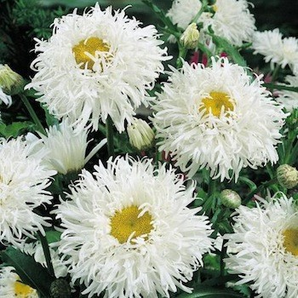
EXHIBITION Shasta Daisy
Displays giant white 5-7 inch, mostly semi and fully double frilled flowers from late spring to September. Grows to 3 feet tall. Winter hardy to zone 3. Easy to Grow - Attracts Butterflies - Excellent Cut Flowers - Combines beautifully with Balloon Flower, Coreopsis, Delphinium, Dianthus, Lupine, Nepeta, Sedum and Yarrow

Slide 11
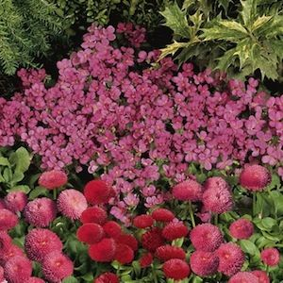
COMPINKIE Wall Rockcress
Arabis caucasica
Superb evergreen compact spreading cushions are covered with thousands of fragrant rosy flowers in early spring. Grows 4-6 inches tall. This dependable favorite forms an evergreen mat of gray-green leaves 4-6 inches tall and 9-12 inches wide. Plants put on a wonderful spring show, covering themselves with clusters of fragrant bright rose-pink flowers in March and April. An excellent spring bulb cover or use as an edging, ground cover, pattern planting or allow them to scramble over rocks or tumble over walls. Prefers afternoon shade in hot climates. Winter hardy to zone 3.

Slide 12
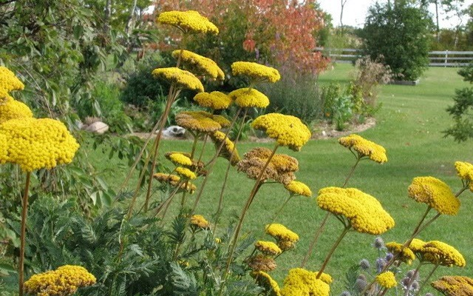
CLOTH OF GOLD Fern-Leaf Yarrow
Achillea filipendula
The feathery foliage is deeply cut and the flat bright yellow flowerheads reach 3-4 inches across. They are excellent cut flowers. Blooms from early summer until frost. Looks terrific with blue delphiniums or red hot pokers. Grows 3-4 feet tall. Winter hardy to zone 3.

Slide 13
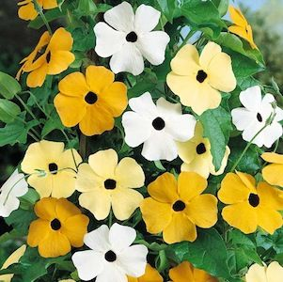
SUSIE MIX Black-Eyed Susan Vine Thunbergia alata
A formula mix of orange, yellow and white blooms with or without contrasting dark eyes. A trailing or twining annual vine with triangular 3 inch leaves and masses of 1-1.5 inch inch wide tubular flowers with or without contrasting dark eyes. Colors include orange, yellow and white. Use as a ground cover, in hanging baskets or train on a trellis or strings.

Slide 14
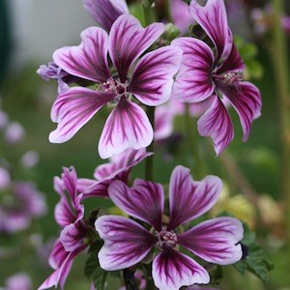
BIBOR FELHO Zebra Hollyhock
A hardy, free blooming perennial which produces purple hibiscus-like blooms with deep plum veining all summer long. The tall, sturdy plants grow 3-4 feet tall. Good for borders and backgrounds and is excellent for cutting. "Bibor Felho" is Hungarian for "Purple Haze." Winter hardy to zone 3.

Slide 15
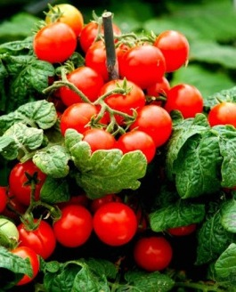
SWEET 'N' NEAT SCARLET Patio Tomato
60 days
Dwarf, compact, branching 12-18 inch plants produce masses of tasty round 1 inch scarlet fruits. An outstanding selection for containers 5 or more inches in diameter. Determinate.

Slide 16
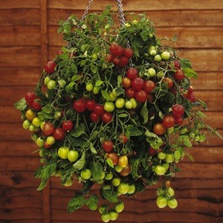
TUMBLING TOM RED Patio Tomato
75 days
Quickly produces sweet and delicious 1-2 inch red round fruits on vigorous, weeping 2 foot plants. These cascading beauties are perfect for hanging baskets, window boxes or patio containers. 3 plants per 10 inch container will put on a delightful show and provide loads of tasty summer fruit. The Tumbling Toms are among our favorite ornamental edibles.

Slide 17
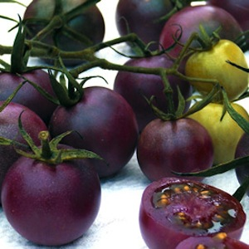
BLACK CHERRY Cherry Tomato
68 days
An outstanding rich-flavored round mahogany colored cherry tomato produced with great freedom on vigorous, tall indeterminate vines

Slide 18
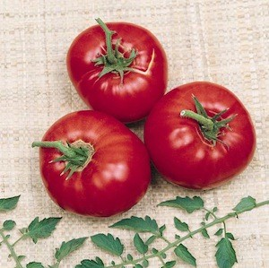
MULE TEAM Tomato 80 days
Vigorous indeterminate vines bear great quantities of bright red 8 ounce tomatoes with great flavor and texture. Produces over a very long season and is an excellent choice for your "main crop" tomato.

Slide 19
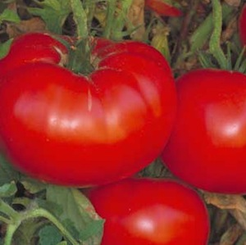
DELICIOUS Tomato 78 days
The huge, meaty fruits are frequently 2 to 3 pounds each and deliver excellent flavor with very little cracking. Declicious holds the world's record (over 7 pounds) for the largest tomato ever grown. Indeterminate vines.

Slide 20
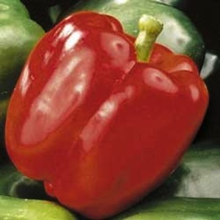
FAT 'N SASSY Bell Pepper
65 days
Heavy, thick-walled 4.5 inch tasty green bells ripen to red. A particularly valuable bell pepper in short season areas, it is heavy yielding and disease resistant.

Slide 21
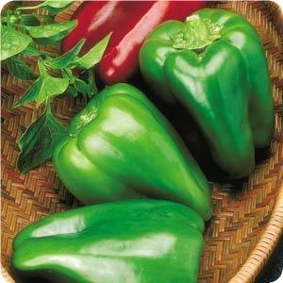
BIG BERTHA Bell Pepper
72 days
Giant four lobed deep green fruits measure up to 8-inches long and 4-inches wide. A widely adapted, proven performer that is great for salads, freezing or stuffing. Highly recommended

Slide 22
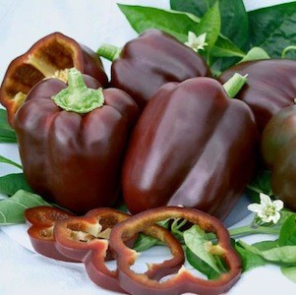
CHOCOLATE BEAUTY HYBRID Bell Pepper
85 days
Gourmet quality, sweet and delicious bells mature from green to a rich chocolate color.

Slide 23
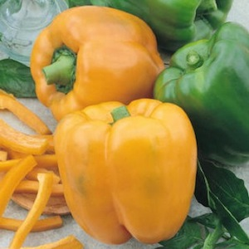
GOLDEN SUMMER Bell Pepper
67 days
A heavy yielder of beautiful golden-yellow four lobed, blocky fruits. They have an outstanding sweet, mild flavor. Excellent stuffed or added to salads.

Slide 24
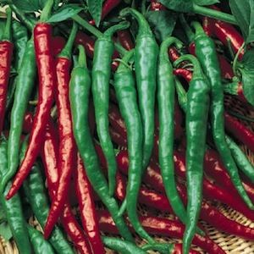
CAYENNE, LONG RED SLIM Hot Pepper
75 days
The 6x3/4-inch red wrinkled fruits are very hot. Dried and crushed they are sprinkled on noodles and pizza and used to make fiery hot sauces.

Slide 25
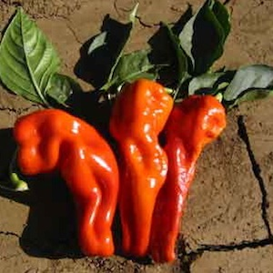
CUBANELLA HYBRID Hot Pepper
75 days
Fried, grilled or roasted these giant 11 inch long, 2 inch wide peppers deliver exhilarating flavor with just the right balance of sweet-hot zest. An Italian type pepper that is especially popular in Caribbean and Puerto Rican cooking. Fruit ripens from green to scarlet on vigorous, bushy, heavy bearing 30 inch plants.

Slide 26
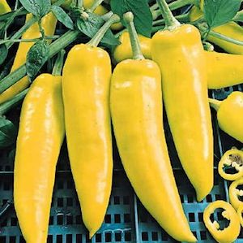
HUNGARIAN YELLOW WAX Hot Pepper
65 DAYS
A 6-inch long tapered, conical, waxy light yellow fruit with thick, mild-medium hot flesh. Good fresh or pickled. High yields even in short season areas.

Slide 27
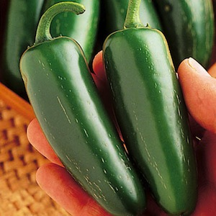
MUCHO NACHO HYBRID Hot Pepper
70 days
Huge, heavy, juicy thick-walled 4 inch jalapenos are mild enough to enjoy fresh from the garden and are the best jalapeno for stuffing or pickling. Strong, vigorous, productive plants reach 20-30 inches tall.

Slide 28
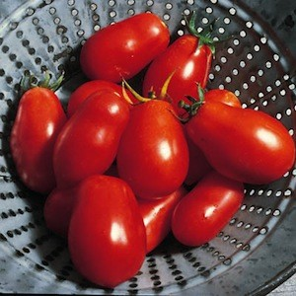
ROMA Tomato 65 days
Incredible yields of very richly flavored pear tomatoes that weigh about 2 ounces, and are 3 inches long. These paste-type fruits are meaty with few seeds and not much juice, perfectly suited to cooking, but delicious enough to eat fresh.

